Slide 1
Deck Template
Tetr College of Business
Participants are expected to make a copy of this template and submit their slides.

Slide 2
Flow
For your information; this is not intended to be included in your deck
Team
About the Startup/ purpose
Problem
Solution
Why Now?
Market Size
Competition
Product
Business Model
Financials (projected)

Slide 3
Team
Show that the team has the ability to execute and win.
Demonstrate product-founder fit by highlighting the unique insights and experiences that make this team uniquely suited to solve this problem

Slide 4
Company Purpose
This is your one-liner. It should be crisp, compelling, and clearly articulate your vision. Avoid listing all features here.

Slide 5
Problem
Sell the pain. The problem must be big enough and worth solving to support a scaling business.
Explain why existing solutions/ customer workarounds don't "cut it".

Slide 6
Solution
The solution is your gift that helps the customer (protagonist) beat the problem (antagonist).
Articulate the value proposition clearly (e.g., "We help X do Y by offering Z").
Emphasize the benefit, not just the features (ask: ‘so what?’)

Slide 7
Why now
Identify the market shift, inflection point, or market asymmetry that creates the substantial opportunity right now.
This sets up your startup as a change-maker, not just a small player in an existing market

Slide 8
Market Size
Focus on the bottom-up calculation (SAM), as it demonstrates deep consumer insight and a granular understanding of your core market.
Use the top-down TAM calculation as a sanity check.
Show the market is large and growing (e.g., aiming for $500M TAM, $50M SAM)

Slide 9
Competition
Demonstrate a clear handle on the industry structure and where your startup fits into the value chain.
Detail how you are different, not just better.
Explain how you will create or dominate a specific market segment (e.g., category creation)

Slide 10
Product
Articulate your product with absolute clarity and in a structured way (e.g., a multi-layered stack for SaaS or platform architecture for marketplaces).
Explain the foundational layer (architecture/IP) that enables your offering and creates credibility.
The roadmap shows future scalability

Slide 11
Business Model
Describe the holistic model: how you create, deliver, and capture value.
Clearly chart your path to your first million in revenue (R=P x Q), aligning your go-to-market (GTM) strategy (B2C, SME, or Enterprise) with your pricing.
Detail the business moats (defense)

Slide 12
Financials (at ideation stage; it is mostly projections)
This section is your Traction slide(s).
Demonstrate Product-Market Fit through operational metrics (acquisition, usage, retention).
Show a strong economic engine by maximizing LTV/CAC.
Use a P&L template to show trends, focusing on clean definitions of Gross Margin and Contribution Margin.

Slide 13
Pro Tip
To summarize, your pitch deck should serve as a cohesive narrative, where your strong performance data and financial projections (lagging indicators) are firmly rooted in your compelling market shift thesis (leading indicators).
Think of your deck not just as information, but as a roadmap to the promised land you are offering your customer.

Slide 14
Appendix

Slide 15
Sample Table

Slide 16
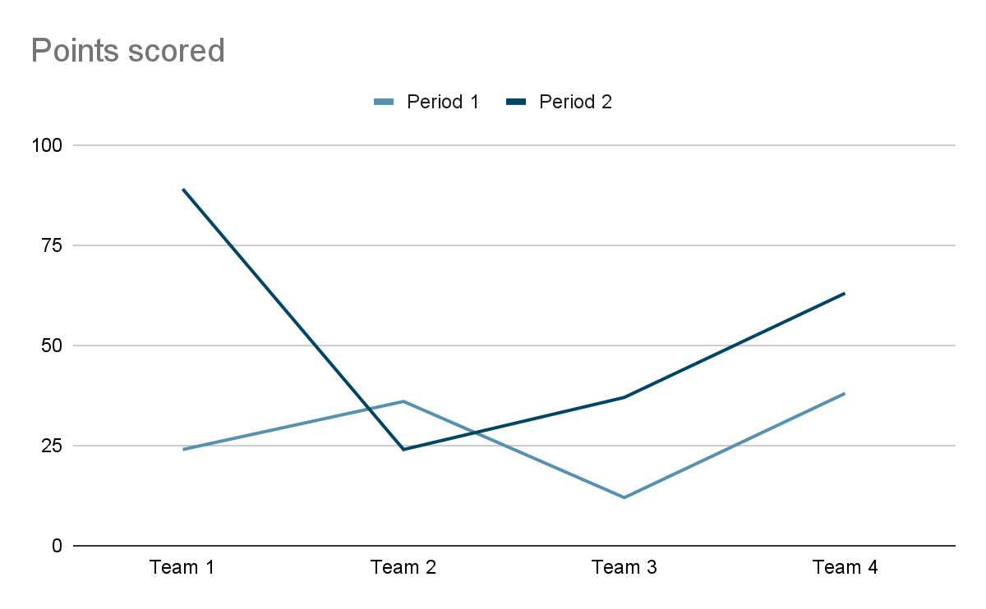
Sample Graph

